Slide 1
Quantum Algorithms Deutsch-Jozsa
Dhinakaran Vinayagamurthy
Researcher
IBM Quantum Ambassador
IBM Research India

Slide 2
Quantum algorithms
Goal of study on quantum algorithms:
Find problems which quantum computers solve faster than any classical computer

Slide 3
Quantum algorithms: history
Some initial problems studied
Didn’t care about real-world applications
Deutsch
-Jozsa
Bernstein
-Vazirani
Simon
Found this result while trying to prove that quantum computers are not any better than classical computers 😄
1992
1992
1993
Notes:
TODO: Create a detailed history chart for all algorithms for more advanced courses.

Slide 4
Quantum algorithms: history
Factor N = p.q for large primes p, q: break RSA cryptosystem
Deutsch
-Jozsa
Bernstein
-Vazirani
Simon
Shor
1992
1992
1993
1994
Notes:
TODO: Create a detailed history chart for all algorithms for more advanced courses.

Slide 5
Quantum algorithms: history
Quadratic improvement in Search
Deutsch
-Jozsa
Bernstein
-Vazirani
Simon
Shor
Grover
1992
1992
1993
1994
1996
Notes:
TODO: Create a detailed history chart for all algorithms for more advanced courses.

Slide 6
Quantum algorithms: history
General optimization
Deutsch
-Jozsa
Bernstein
-Vazirani
Simon
Shor
Grover
VQE
QAOA
…
1992
1992
1993
1994
1996
2014
2014
Notes:
TODO: Create a detailed history chart for all algorithms for more advanced courses.

Slide 7

Quantum algorithms: history
QML
Pricing option contracts
Deutsch
-Jozsa
Bernstein
-Vazirani
QC in cloud
Battery
optimization
Simon
Shor
Grover
VQE
QAOA
…
…
1992
1992
1993
1994
1996
2014
2014
2016
2018 -
Notes:
TODO: Create a detailed history chart for all algorithms for more advanced courses.

Slide 8
Quantum algorithms: history
QML
Pricing option contracts
Deutsch
-Jozsa
Bernstein
-Vazirani
QC in cloud
Battery
optimization
Simon
Shor
Grover
VQE
QAOA
…
…
1992
1992
1993
1994
1996
2014
2014
2016
2018 -
Notes:
TODO: Create a detailed history chart for all algorithms for more advanced courses.

Slide 9
What does it mean for a Quantum computer to be faster than a classical computer?

Slide 10
Complexity of algorithms
Different notions of measuring performance:
Computational complexity: Measure computation time taken by the algorithm
Space complexity: Measure space/memory used by the algorithm
Communication complexity: for distributed algorithms
Information complexity: for distributed algorithms
Query complexity

Slide 11
Query complexity
Assumes the existence of an oracle for a problem
Oracle: a black-box which provides answer to the problem of choice

Slide 12
Oracle
Oracle
Query complexity of algorithm = Time taken by main module + Number of calls to Oracle
Algorithm

Slide 13
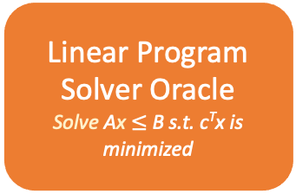
Oracle – examples
Logarithm Computation Oracle
Linear Program Solver Oracle Solve Ax $≤$ B s.t. c^{T}x is minimized
Prime Factorization Oracle
Boolean Satisfiability Solver Oracle
Algorithm
Algorithm
Algorithm
Algorithm

Slide 14
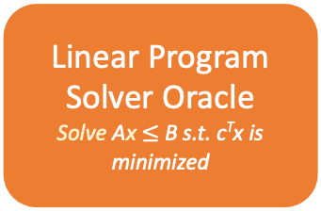
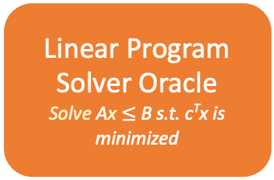
Oracle – differentiate complexities of algorithms
Linear Program Solver Oracle Solve Ax $≤$ B s.t. c^{T}x is minimized
Linear Program Solver Oracle Solve Ax $≤$ B s.t. c^{T}x is minimized
Query complexity of algorithm = Time taken by main module + Number of calls to Linear Program (LP) Solver Oracle
Solving linear equations = unit time
Graph coloring (NP-complete) = exponential time in the worst case
Solve a system of linear equations
Graph-coloring Algorithm

Slide 15
Query complexity
Assumes the existence of an oracle for a problem
Used to separate complexity classes
Natural model to prove power of quantum computers over classical computers
Oracle: a black-box which provides answer to the problem of choice

Slide 16
Deutsch-Jozsa algortihm

Slide 17
Motivation for Deutsch and Jozsa
Goal: To create a separation between the power of classical and quantum computers
Result: A problem which
for all inputs, quantum computers can solve with certainty in polynomial time but
classical computers take exponential time to solve with certainty.
Separation between EQP (Exact Quantum Polynomial) and P

Slide 18
Motivation for us
Two perspectives to study this problem:
Show why a quantum computer is powerful than any classical computer in such settings
Learn fundamental quantum modules that enable quantum computers to be powerful

Slide 19
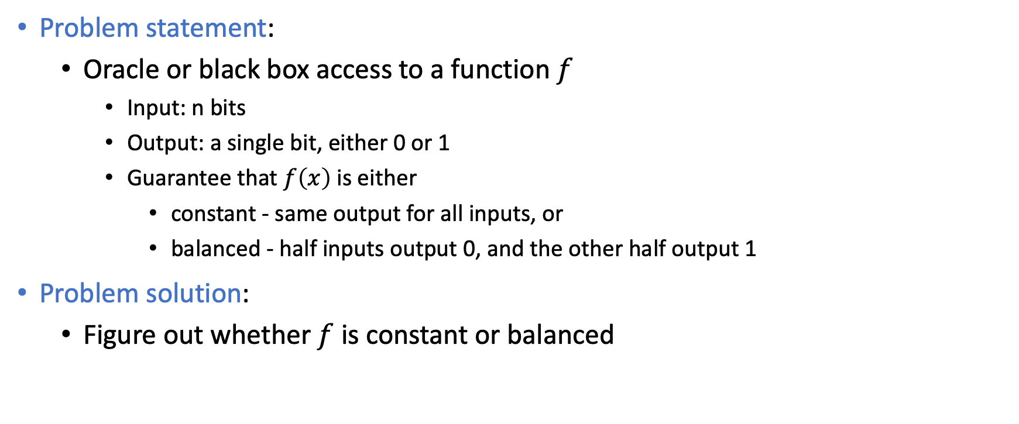
Problem
Problem statement:
Oracle or black box access to a function $f$
Input: n bits
Output: a single bit, either 0 or 1
Guarantee that $f\left(x\right)$is either
constant - same output for all inputs, or
balanced - half inputs output 0, and the other half output 1
Problem solution:
Figure out whether $f$ is constant or balanced

Slide 20
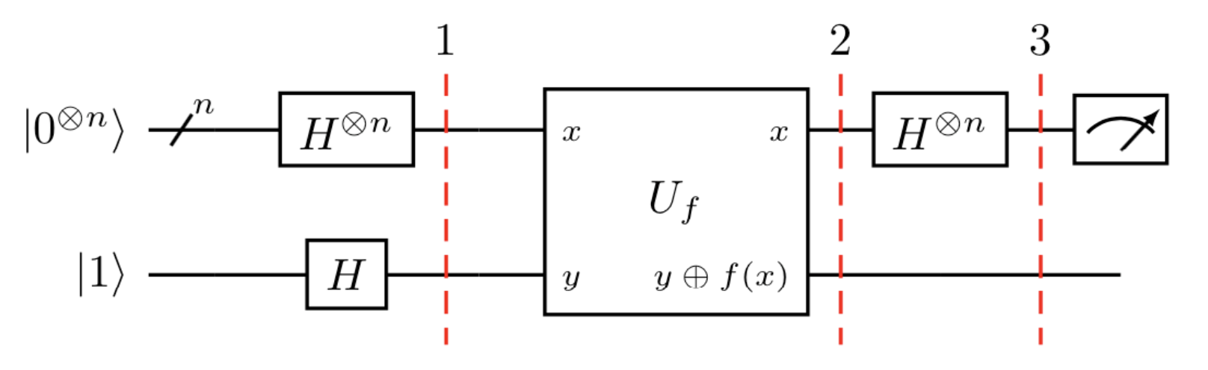
Oracle for f

Slide 21
Oracle for f: Classical
n bit input
n bit output
1 bit input
1 bit output

Slide 22
Oracle for f: Quantum
n qubit input
n qubit output
1 qubit input
1 qubit output

Slide 23
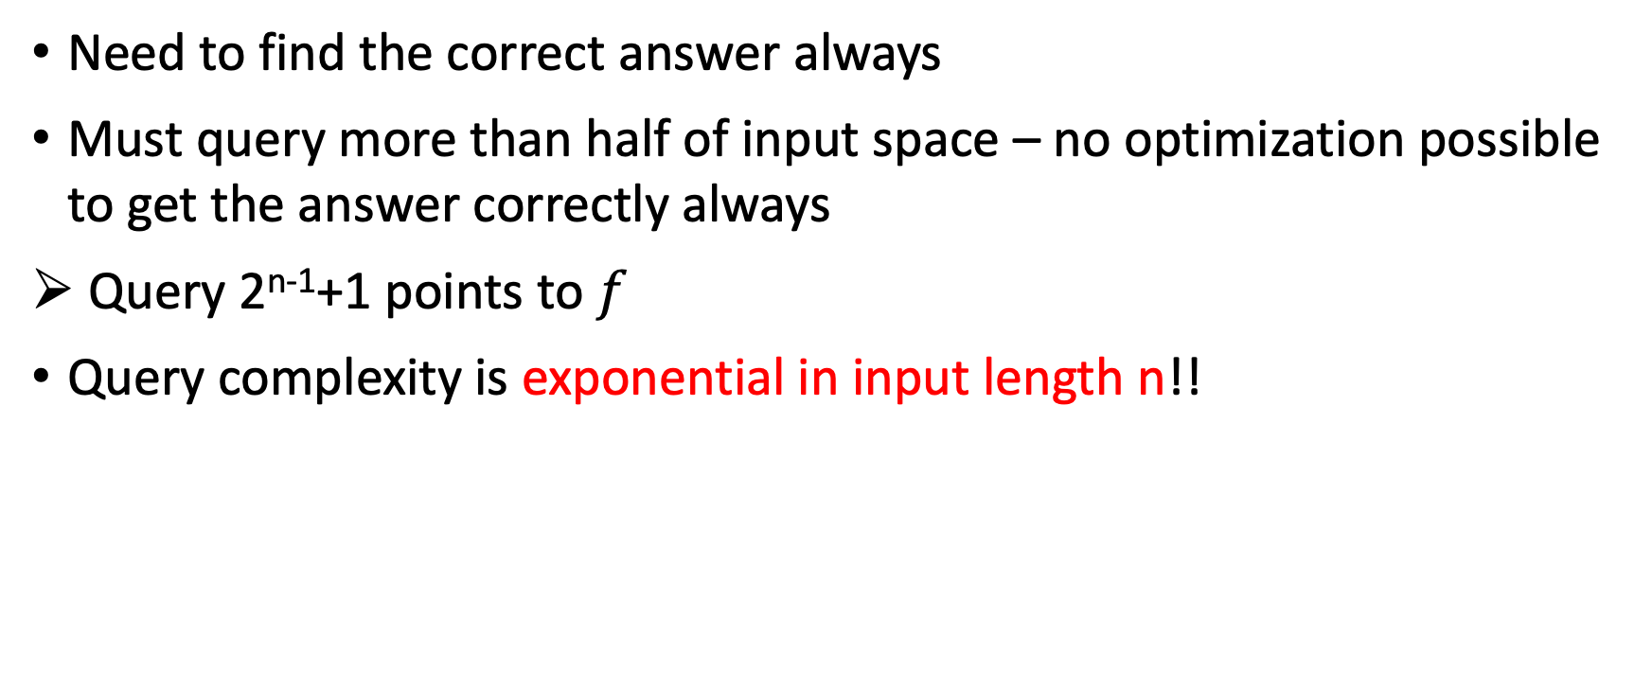
Classical algorithm for DJ problem
Need to find the correct answer always
Must query more than half of input space – no optimization possible to get the answer correctly always
Query 2^{n-1}+1 points to $f$
Query complexity is exponential in input length n!!

Slide 24
Quantum algorithm for DJ problem
!! Solves this problem with certainty in polynomial time !!
We will see now how this happens!

Slide 25
Quantum algorithm
Step 0
Input

Slide 26
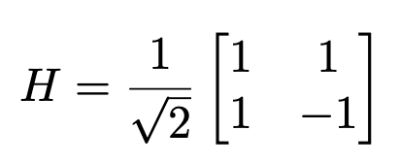

Step 1: Hadamard transform

Slide 27
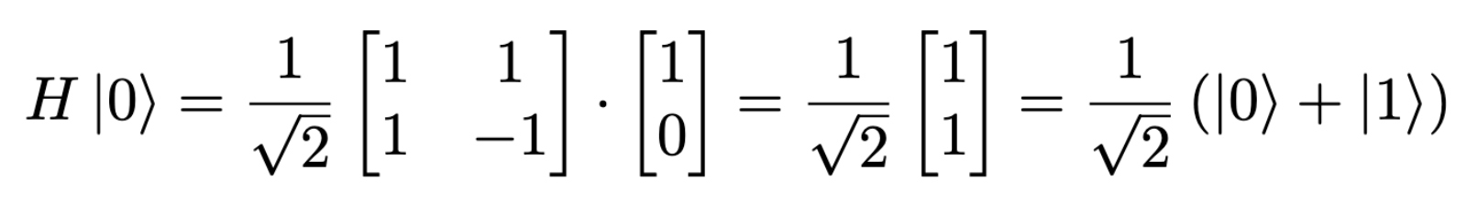
Step 1: Hadamard transform

Slide 28
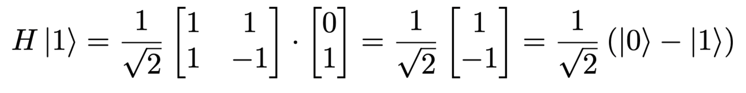
Step 1: Hadamard transform

Slide 29
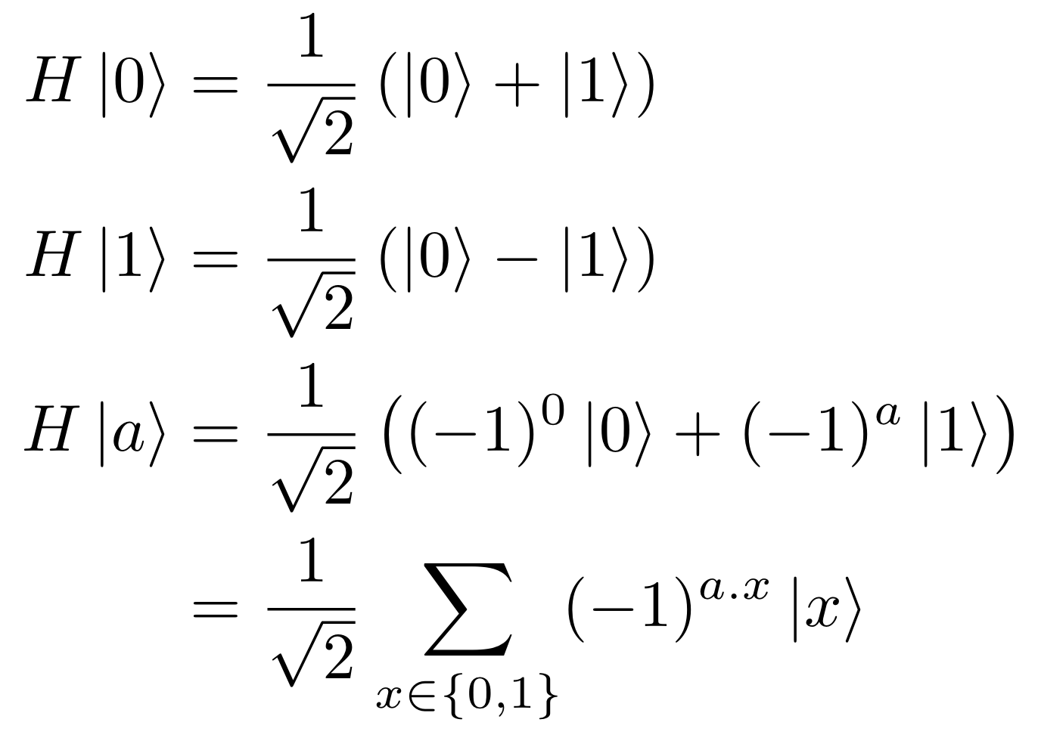
Step 1: Hadamard transform

Slide 30
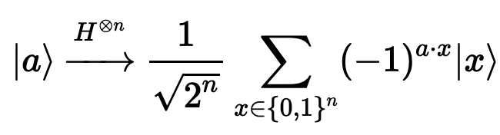
Step 1: Hadamard transform

Slide 31
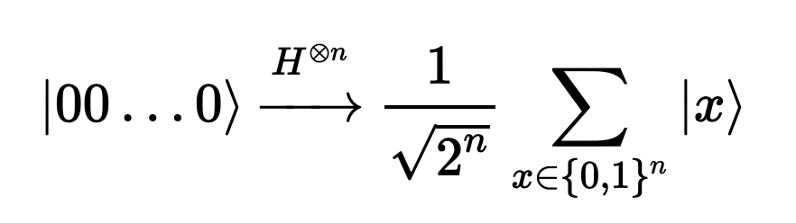
Step 1: Hadamard transform
Just follow the n qubits input to the function

Slide 32
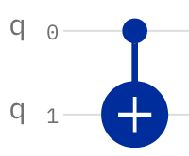
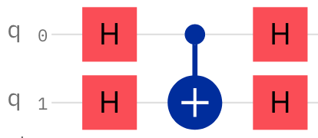
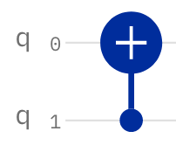
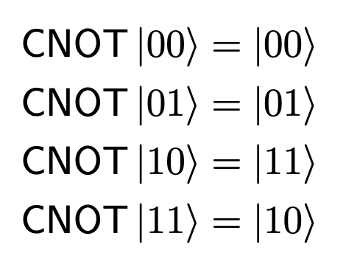
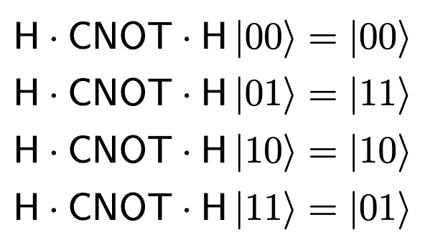
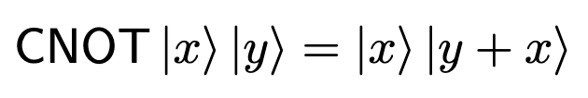
Tool for Step 2: Phase kickback

Slide 33
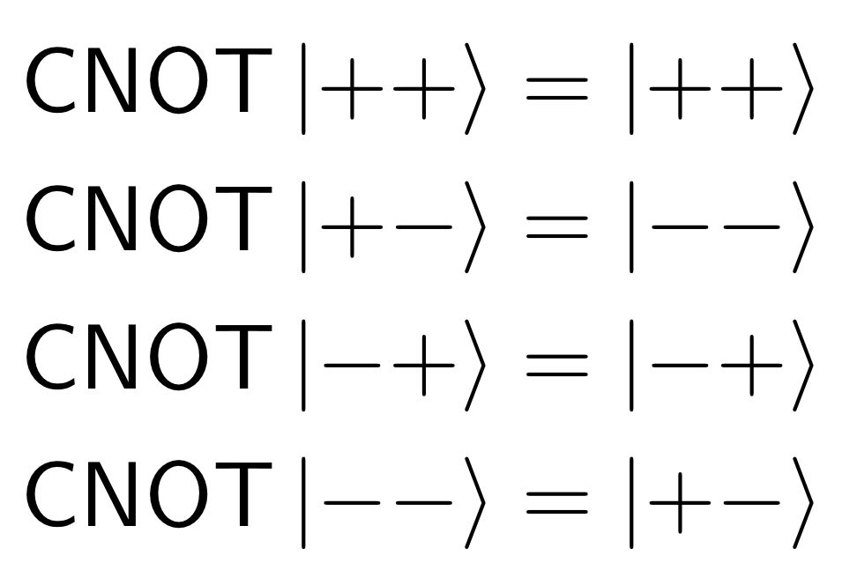
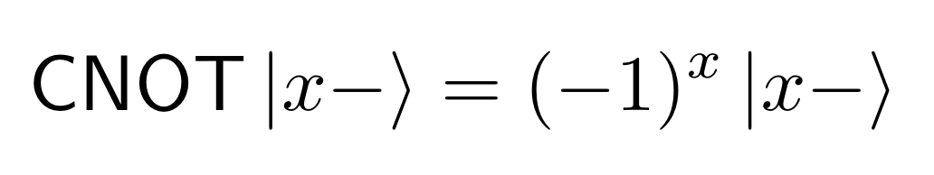
Tool for Step 2: Phase kickback

Slide 34


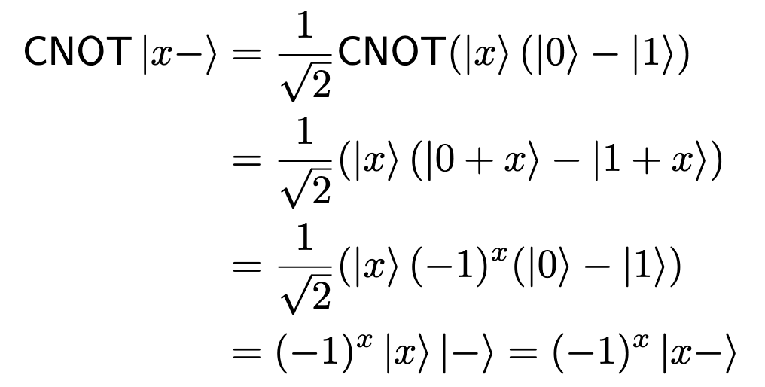
Tool for Step 2: Phase kickback

Slide 35
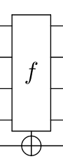
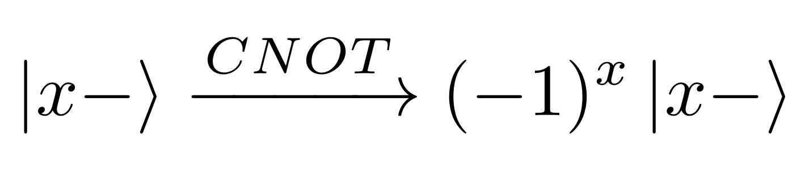
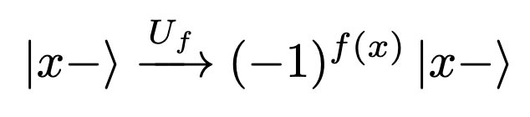
Step 2: Phase kickback

Slide 36
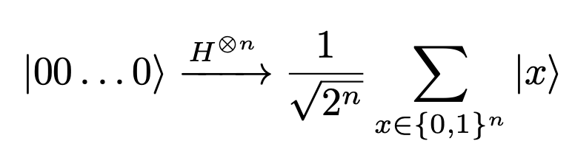
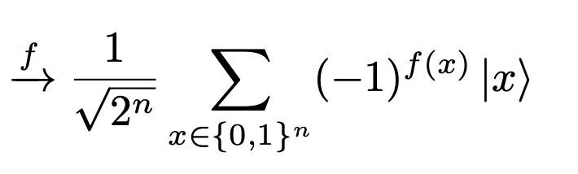
Step 2: Phase kickback

Slide 37

Step 3: Hadamard transform
Recall

Slide 38
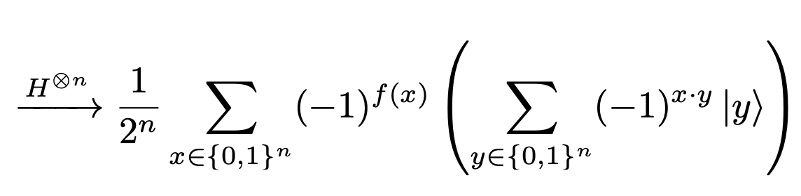
Step 3: Hadamard transform

Slide 39
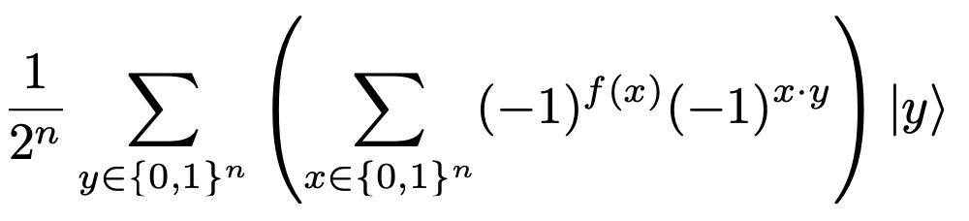
Step 3: Hadamard transform
Rewritten as

Slide 40
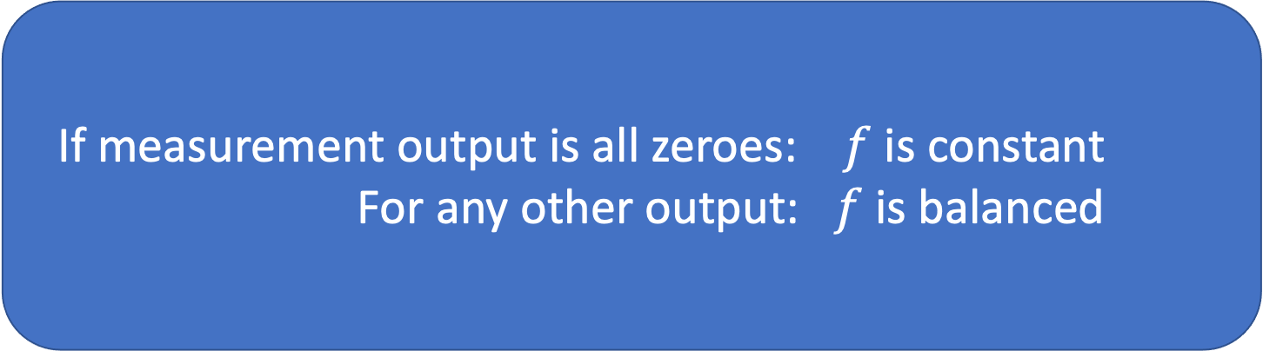
Step 4: Measure first n qubits
If measurement output is all zeroes: $f$ is constant
For any other output: $f$ is balanced
Rewritten as

Slide 41
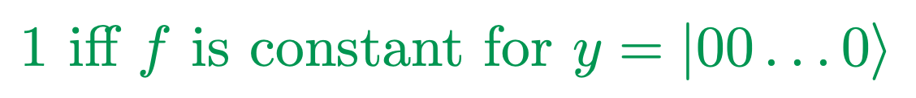
Step 4: Measure first n qubits
Rewritten as

Slide 42
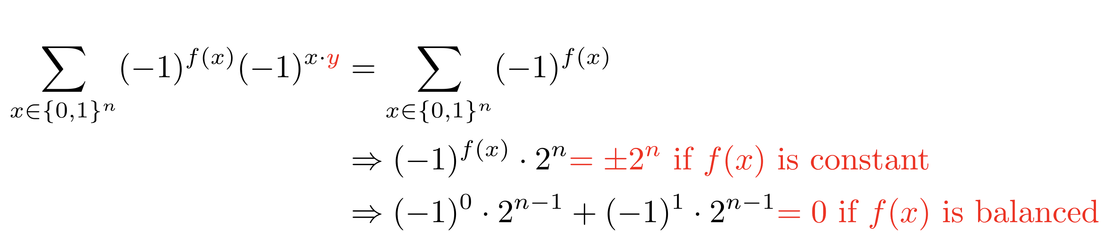
Step 4: Measure first n qubits
Rewritten as

Slide 43
Qiskit Implementation of Deustch-Jozsa

Slide 44
Quantum algorithm

Slide 45




Oracle for f: Quantum
n qubit input
n qubit output
1 qubit input
1 qubit output
f $≡$ 0
f $≡$ 1
Constant f

Slide 46
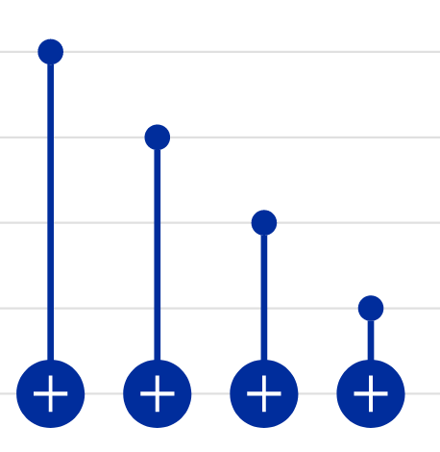
Oracle for f: Quantum
n qubit input
n qubit output
1 qubit input
1 qubit output
Balanced f
Eg:

Slide 48
Bernstein-Vazirani algortihm

Slide 49
Motivation for BV
DJ: quantum computers can solve a problem with certainty in polynomial time but classical computers take exponential time on some inputs with certainty.
Probabilistic algorithms (a la BPP) allows for wrong answers with small probability. These are considered a practical class for classical computers.
Classical BPP algorithms take polynomial time to solve the DJ problem.

Slide 50
DJ classical algorithm
P version : Query 2^{n-1}+1 points.
BPP version : Query random set of points
Intuition:
For a balanced function,
Two buckets to choose from
Probability of inputs to keep coming from a single bucket reduces exponentially.

Slide 51
Motivation for BV
DJ: quantum computers can solve a problem with certainty in polynomial time but classical computers take exponential time on some inputs with certainty.
Probabilistic algorithms allows for wrong answers with small probability. These are considered a practical class for classical computers.
Classical BPP algorithms take polynomial time to solve the DJ problem.
BV:
A problem which quantum computers can solve with very high probability, but any classical computer cannot solve with probability > ½ using the same time as a quantum computer.
Oracle separation between BPP and BQP

Slide 52
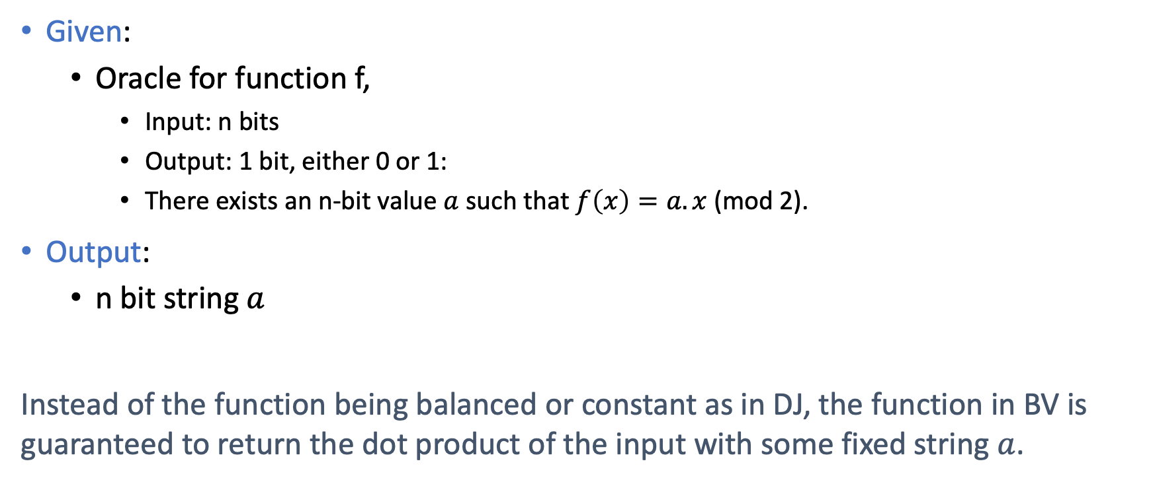
Problem
Given:
Oracle for function f,
Input: n bits
Output: 1 bit, either 0 or 1:
There exists an n-bit value $a$ such that $f\left(x\right)=a. x$(mod 2).
Output:
n bit string $a$
Instead of the function being balanced or constant as in DJ, the function in BV is guaranteed to return the dot product of the input with some fixed string $a$.

Slide 53
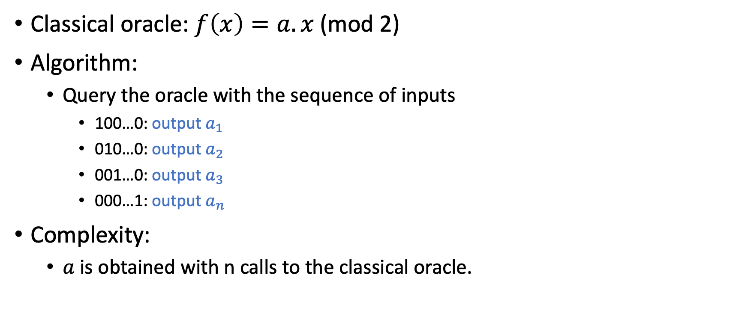
Classical solution
Classical oracle: $f\left(x\right)=a. x$(mod 2)
Algorithm:
Query the oracle with the sequence of inputs
100…0: output $a_{1}$
010…0: output $a_{2}$
001…0: output $a_{3}$
000…1: output $a_{n}$
Complexity:
$a$ is obtained with n calls to the classical oracle.

Slide 54
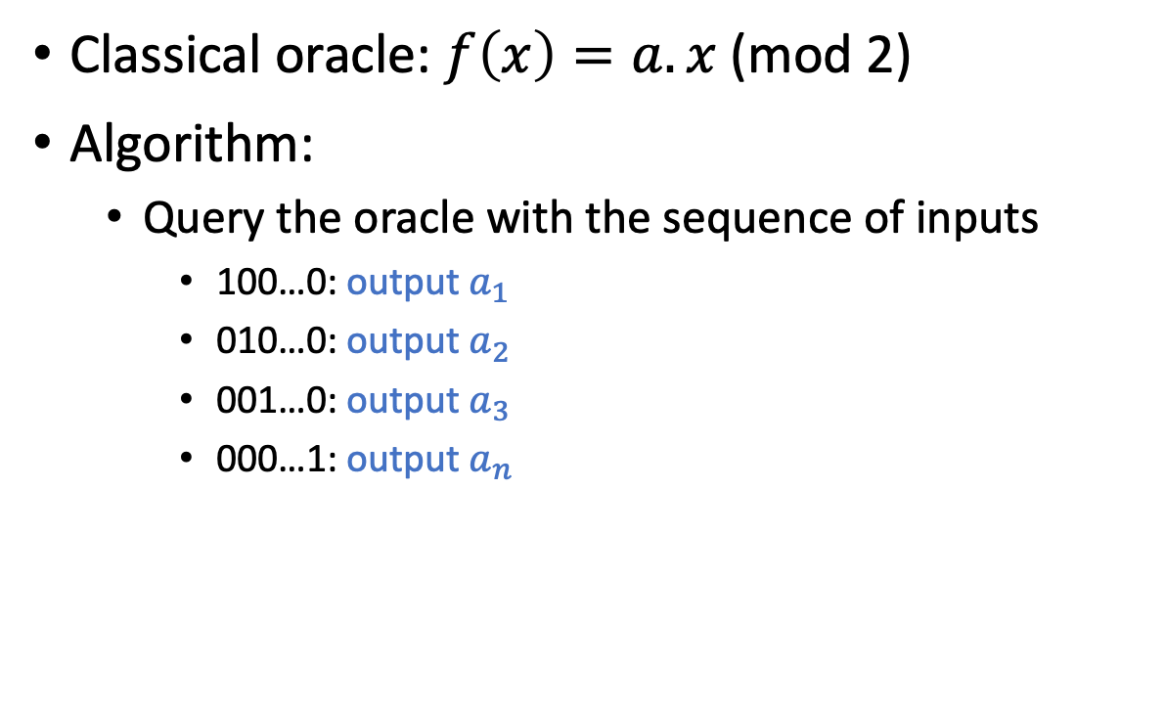
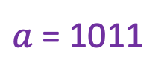
Classical solution
Classical oracle: $f\left(x\right)=a. x$(mod 2)
Algorithm:
Query the oracle with the sequence of inputs
100…0: output $a_{1}$
010…0: output $a_{2}$
001…0: output $a_{3}$
000…1: output $a_{n}$
$a$ = 1011
1000 . 1011 = 1
0100 . 1011 = 0
0010 . 1011 = 1
0001 . 1011 = 1

Slide 55
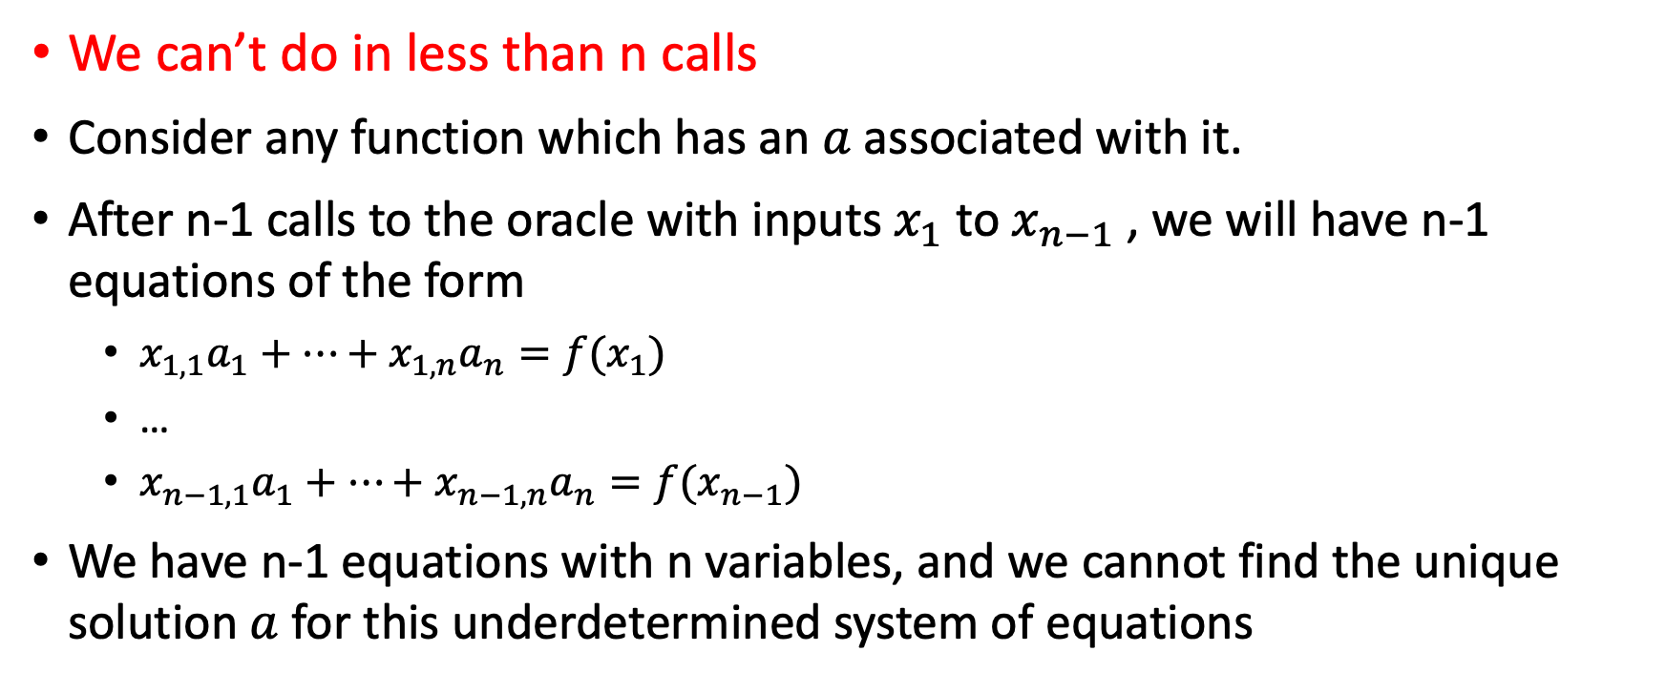
Classical solution: Lower bound
We can’t do in less than n calls
Consider any function which has an $a$ associated with it.
After n-1 calls to the oracle with inputs $x_{1}$ to $x_{n−1}$, we will have n-1 equations of the form
${x_{1,1}a}_{1}+…+x_{1,n}a_{n}=f(x_{1})$
…
${x_{n−1,1}a}_{1}+…+x_{n−1,n}a_{n}=f(x_{n−1})$
We have n-1 equations with n variables, and we cannot find the unique solution $a$ for this underdetermined system of equations

Slide 56

Quantum solution
Same as DJ !!
$$a$$

Slide 57
Step 1: Hadamard transform
Just follow the n qubits input to the function

Slide 58
Step 1: Hadamard transform

Slide 59
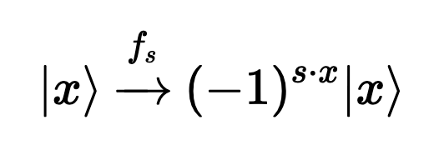


Step 2: Phase kickback
$$a$$
$$a$$

Slide 60
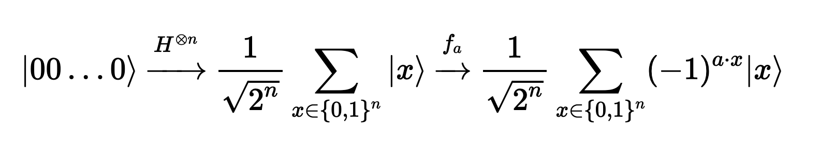
Step 2: Phase kickback

Slide 61
Step 3: Inverse Hadamard transform
Inverse of H is H !!

Slide 62
Qiskit Implementation of Bernstein-Vazirani

Slide 63
Thank you!

Slide 64
Backup

Slide 65
Oracle – examples
Logarithm Computation Oracle
Distance between two adjacent vertices in a graph
Prime Factorization Oracle
Boolean Satisfiability Solver Oracle
Algorithm
Algorithm
Algorithm
Algorithm

Slide 66
Oracle – differentiate complexities of algorithms
Distance between two adjacent vertices in a graph
Distance between two adjacent vertices in a graph
Total time take by algorithm = Time taken by main module + Number of calls to Distance Oracle
Testing adjacency between vertices = One call to the Distance oracle
Algorithm to find shortest path between any pair of vertices in a graph = polynomial calls to Distance oracle
Test whether a pair of vertices in a graph are adjacent
Shortest Path Algorithm

Slide 67
Oracle – differentiate complexities of algorithms
Distance between two adjacent vertices in a graph
Distance between two adjacent vertices in a graph
Total time take by algorithm = Time taken by main module + Number of calls to Distance Oracle
Testing adjacency between vertices = One call to the Distance oracle
Longest path (NP-complete) = exponential calls to Distance oracle in the worst case
Test whether a pair of vertices in a graph are adjacent
Longest Path Algorithm

